Slide 1
Linear Regression – Convexity of Error Function
Prof.N.L.Bhanu Murthy

Slide 2
Linear Regression

Slide 3
Linear Regression

Slide 4
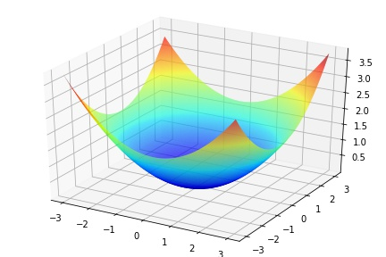
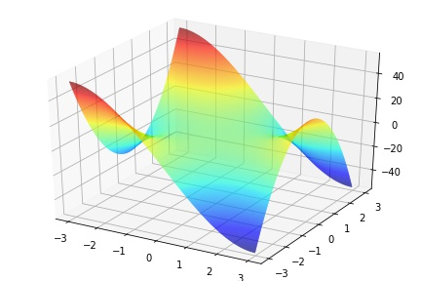
Linear Regression

Slide 5
Regression

Slide 6
Thank You!

